Slide 1




High Throughput Cryptocurrency Routing in Payment Channel Networks
Vibhaalakshmi Sivaraman, Shaileshh Venkatakrishnan, Kathleen Ruan,
Parimarjan Negi, Lei Yang, Radhika Mittal, Giulia Fanti, Mohammad Alizadeh
Notes:
Thanks
It’s great to be here and I am going to be talking about how we can increase transaction throughput on payment channels in today’s blockchains using ideas from computer networks.
This is joint work with my collaborators at MIT, CMU and UIUC.

Slide 2
Cryptocurrencies today
Example: Bitcoin
$400-$800 million worth of Bitcoin is transacted every day
7.1 million active users
5% of Americans hold Bitcoin
Heavily used in emerging markets
Notes:
100s of millions of Bitcoin is transacted every day
7.1 million active users with 5% of Americans holding Bitcoin
especially in places where currencies where there's inflation in native currency
majority of this is for people holding it as investments -
promise of bitcoin wasn't for this - it was meant to be used as a form of payment - no one uses it why

Slide 3
Cryptocurrencies don’t scale
Example: Bitcoin
THROUGHPUT
~ 5 transactions / s
LATENCY
∼1 hr confirmation time
FEES
~ $0.5, reached $50 in December 2017
Notes:
ONE REASON FOR THIS
Cryptocurrencies don’t scale as they are today. For instance, Bitcoin can support only around 5 txns/second in contrast to the 1000s of transactions that VISA supports.
A given transaction can take around an hour to be confirmed. And further, transactions are expensive: a given transaction can cost around $0.5 with the highest being as high as $50.
Let’s try to understand why this might be the case.

Slide 4

Ledger of all transactions
Blockchain
(1)
4
(2)
5
(3)
Alice
3
Bob
Miners
(4)
Mary
5
Eve
(5)
Alice
Bob
Global consensus
for every transaction
4
Charlie
Eve
Alice
Bob
Notes:
The way bitcoin works it uses a distributed ledger that contains a list of all transactions organized in blocks chained together.
A transaction between two parties first needs to be broadcasted to a group of miners who validate and include it in the next block
This process of including it in the next block involves consensus and can take upto 10 minutes in bitcoin’s case.
What’s worse is every transaction in the system needs to go through this process.
It requires global consensus every transaction to be sent to every person in the world.
look at micropayment use cases - why would anyone ever want to know,
storage and bandwidth cost will hit the roof

Slide 5
Payment channels
(1)
1
4
3
Open
Channel
2
Alice
Bob
Key Idea: Use blockchain (as arbiter) only as necessary!
Notes:
Payment channels act somewhat like a gift card or a joint account.
Alice and Bob decide to put 7 units into a common fund like a gift card by making a blockchain transaction. The blockchain records the existence of the channel and the initial balances of Alice and Bob in the channel.
Now if Alice were to send some money over to Bob, she would just sign a new message confirming that Bob owns 4 of these and herself 3
None of these compromise the security of the system

Slide 6
Payment channels
(1)
1
4
3
1
(2)
3
4
4
Open
Channel
3
Txn 1
Alice sends Bob a signed message, confirming new balances
2
Alice
Bob
2
Alice
Bob
Key Idea: Use blockchain (as arbiter) only as necessary!
Notes:
Now when alice wants to send one unit over --- signs new balance messages

Slide 7
Payment channels
(1)
1
4
3
1
(2)
Open
Channel
(3)
Txn 1
5
3
2
4
2
Alice
Txn 2
Bob
2
Alice
Bob
Alice
- Alice
Bob
Key Idea: Use blockchain (as arbiter) only as necessary!
Notes:
Similarly if Bob decided to send 2 units to Alice, he would sign a message accepting that the balance was 5 towards Alice and 2 towards Bob
The two of them can continue this until and unless they decide they are done transacting at which point they can tell the blockchain so

Slide 8
Payment channels
(1)
1
4
3
1
(2)
3
4
Open
Channel
(3)
Txn 1
5
2
(4)
5
2
Alice
Txn 2
Bob
2
2
Alice
(5…)
Txn 2
Bob
5
2
Alice
- Alice
Txn 2
(n)
Bob
5
2
Does not require trust
Alice
- Bob
Bob
Close
Channel
- Bob
Alice
Bob
Alice
- Bob
Bob
Notes:
The two of them can continue this until and unless they decide they are done transacting at which point they can tell the blockchain so. At that point, they close out with a transaction saying Alice took 5 of the coins from their common account and Bob took 2 of them.
This whole process requires no trust between Alice and Bob. If one party tries to publish an older balance using an old signed message, the other party can override it with a newer message. Further, cheating is punished by taking away the money of the other party.

Slide 9
Payment channel networks
Alice wants to send
3 coins to Bob
Alice
Charlie
6
6
3
Bob
0
1
1
3
3
3
1
Eve
Mary
Notes:
For Alice to send 3 tokens to Bob, Charlie is an apt intermediary. She can send 3 coins to charlie who can send 3 coins to bob. All of this can be done in a secure manner. Further, Intermediate nodes are incentivized via routing fees (typically a fraction of the amount being sent).

Slide 10
Payment channel networks
Alice wants to send
3 coins to Bob
Alice
Charlie
6
6
3
Bob
0
1
1
3
3
3
1
Eve
Mary
Notes:
CHARLIE COLLECTS ROUTING FEES

Slide 11

Payment channel networks
Alice wants to send
3 coins to Bob
Alice
Charlie
6
6
6
3
3
3
Bob
3
0
1
1
3
3
Does not require trust!
3
1
(hash-locked transfers)
Eve
Mary
Notes:
Each transaction is locked with a key such that if the receiving party posseses the key, they can claim the money in one of two ways: 1 -) on the blockchain itself but this closes the payment channel
2) By passing on the key to their upstream partner
To do this in a secure manner
This makes the scheme incentive compatible and secure at the same time.
Once Charlie posses the key, the funds have already been claimed by Bob and he’d want to claim his share from Alice. In order to keep the channel alive, he’d in the average case prefer to send it to alice.
Charlie cannot claim his funds from Alice before Bob claims his by passing Charlie the key

Slide 12
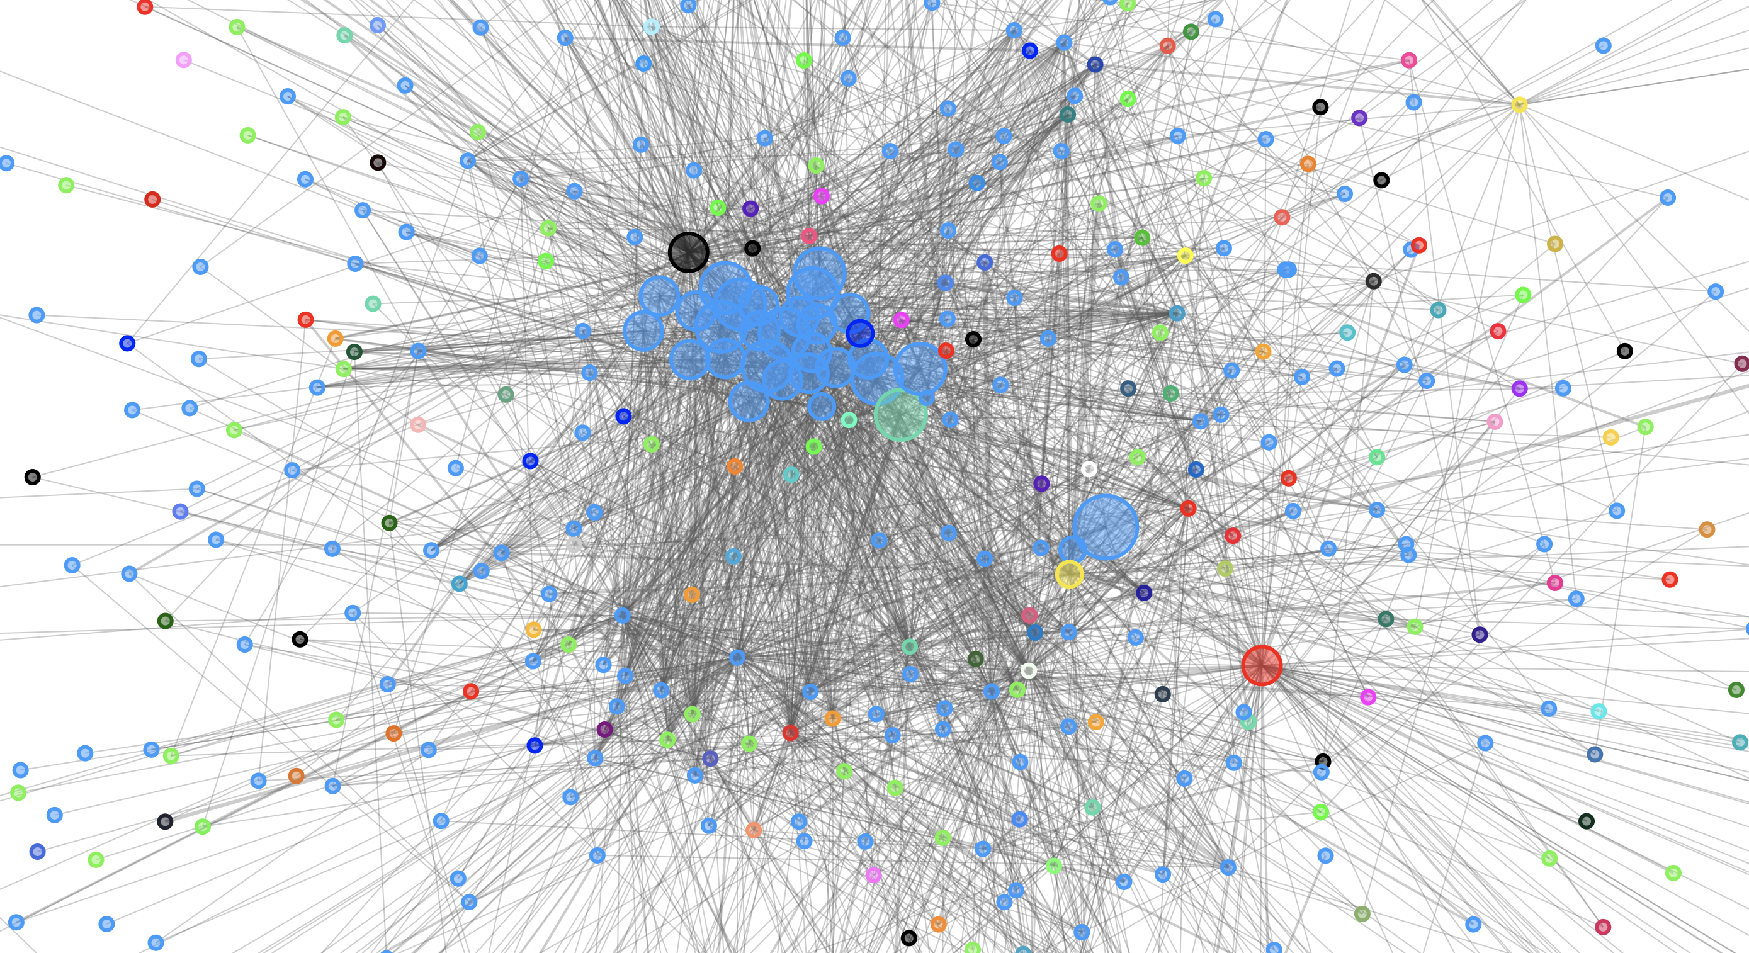
The Lightning Network
6532 active nodes
35,820 channels
874.16 BTC capacity
(~ $9 Million)
1500% growth in 1 year
Accepted by over 4,000 merchants
Sources: https://1ml.com/visual/network, https://graph.lndexplorer.com/
Notes:
This idea of payment channels has actually seen deployment in the form of the LN which has the following properties:
Our work is about routing because the success of these attempted payments to merchants critically depends on it
it has a huge impact on use and viability - we want to focus specifically on the routing of payments

Slide 13
How to route payments?
Alice
Charlie
4
6
2
Bob
3
1
1
3
3
State of the art:
Atomic shortest path routing
3
1
Eve
Mary
Alice wants to send
4 coins to Bob
Notes:
Routing decisions today are made using shortest path routing.
What does this mean?
CIRCUIT SWITCHED NETWORK - NEED RESOURCES UPFRONT ON ALL THE HOPS
STRESS ON WHY ITS ATOMIC (in full) and shortest

Slide 14
Atomic shortest path routing
Alice
Charlie
4
6
2
Bob
3
1
Alice wants to send
4 coins to Bob
1
3
3
3
1
Eve
Mary
Notes:
A single path that can support all 4 coins – first path is via Charlie
congestion control as opposed to a multipath transport protocol
the second channel

Slide 15
Atomic shortest path routing
Alice
Charlie
4
6
2
Bob
3
1
Alice wants to send
4 coins to Bob
1
3
3
3
1
Eve
Mary
Notes:
Not balance aware

Slide 16
Atomic shortest path routing
Alice
Charlie
4
6
2
Bob
3
1
Alice wants to send
4 coins to Bob
1
3
3
Insufficient funds!
3
1
😟
Eve
Mary
Notes:
Charlie can’t use the 6 coins on the channel with alice towards routing to anyone else because funds are locked up and so on

Slide 17
Atomic shortest path routing
Alice
Charlie
4
6
2
Bob
3
1
Alice wants to send
4 coins to Bob
1
3
3
Insufficient funds!
3
1
😟
Eve
Mary
Notes:
Not balance aware
Alice knows topology but not precise balances, so she attempts the transaction assuming it will go through, but Charlie returns failure
6 coins on Charlie – Alice channel cannot be used with Bob
MENTION THAT FAILING TXNS GO ON MAIN BLOCKCHAIn

Slide 18
Atomic shortest path routing
Alice
Charlie
4
6
Bob
1
Alice wants to send
4 coins to Bob
1
3
3
3
1
Eve
Mary
Notes:
So we have established that Alice can send some money to some intermediary, but this begs the question of which intermediary and what path to use for the payment. In particular, Alice needs to find an intermediary who can send as much funds as she wants to send too. For instance, let’s consider the scenario when alice wants to send 3 more coins to Bob. One option is to use the same path as before which can support the 3 more coins

Slide 19
Atomic shortest path routing
Alice
Charlie
4
6
Bob
1
Alice wants to send
4 coins to Bob
1
3
3
3
1
Eve
Mary
Notes:
Not balance aware

Slide 20
Atomic shortest path routing
Alice
Charlie
4
6
Bob
Alice wants to send
4 coins to Bob
1
No more paths
3
😟
3
1
Eve
Need an on-chain transaction!
Mary
Notes:
Not balance aware

Slide 21
Atomic shortest path routing
Alice
Charlie
6
6
3
Bob
0
1
Alice wants to send
6 coins to Bob
1
3
3
3
1
Eve
Mary
Notes:
Even when payments can be routed, atomic shortest path routing can cause heavy imbalance

Slide 22
Atomic shortest path routing
Alice
Charlie
6
6
3
Bob
0
1
Alice wants to send
6 coins to Bob
1
3
3
3
1
Eve
Mary

Slide 23
Atomic shortest path routing
Alice
Charlie
9
6
6
3
6
0
0
Bob
0
1
Alice wants to send
6 coins to Bob
1
3
3
3
1
Eve
Mary
Notes:
Consider a second case where Alice is able to find a route for her transaction

Slide 24
Imbalanced routers can’t route!
Charlie
Charlie wants to send
3 coins to Mary
Alice
9
6
0
0
Bob
1
1
3
3
3
1
Eve
Mary
Notes:
What is worse is if Charlie wants to send 3 tokens to Bob now, he can’t do so

Slide 25
Imbalanced routers can’t route!
😟
Charlie wants to send
3 coins to Mary
Alice
Charlie
9
6
0
0
Bob
1
1
3
3
3
1
Eve
Mary
Notes:
Because he can’t send any payments to Bob on his direct channel. He also doesn’t have sufficient funds between him and Eve to use that path.
Note that Charlie does have 9 coins between him and Alice but that doesn’t help him get any path to Bob. . He does have coins on the channel with Alice however since that was restricted to transacting only with Alice, if he wants to reallocate, he’d need to go back close our a set of channels and reopen them with a different amount of funds allocated to these channnels – all of this takes time and loses out on the benfits of payment channels
There is money on the routers but it can’t be used

Slide 26
Imbalanced routers can’t route!
Blockchain
Alice
Charlie
9
6
0
0
Bob
(1)
0
1
1
3
Reset
Channel
1
(2)
1
3
3
Reset
Channel
1
1
(3)
2
Alice
3
6
Charlie
1
3
3
Reset
Channel
2
Eve
3
Charlie
3
2
Bob
3
Charlie
3
1
Eve
Mary
Rebalancing transactions are expensive
Notes:
Because he can’t send any payments to Bob on his direct channel. He also doesn’t have sufficient funds between him and Eve to use that path.
Note that Charlie does have 9 coins between him and Alice but that doesn’t help him get any path to Bob. . He does have coins on the channel with Alice however since that was restricted to transacting only with Alice, if he wants to reallocate, he’d need to go back close our a set of channels and reopen them with a different amount of funds allocated to these channnels – all of this takes time and loses out on the benfits of payment channels
There is money on the routers but it can’t be used

Slide 27


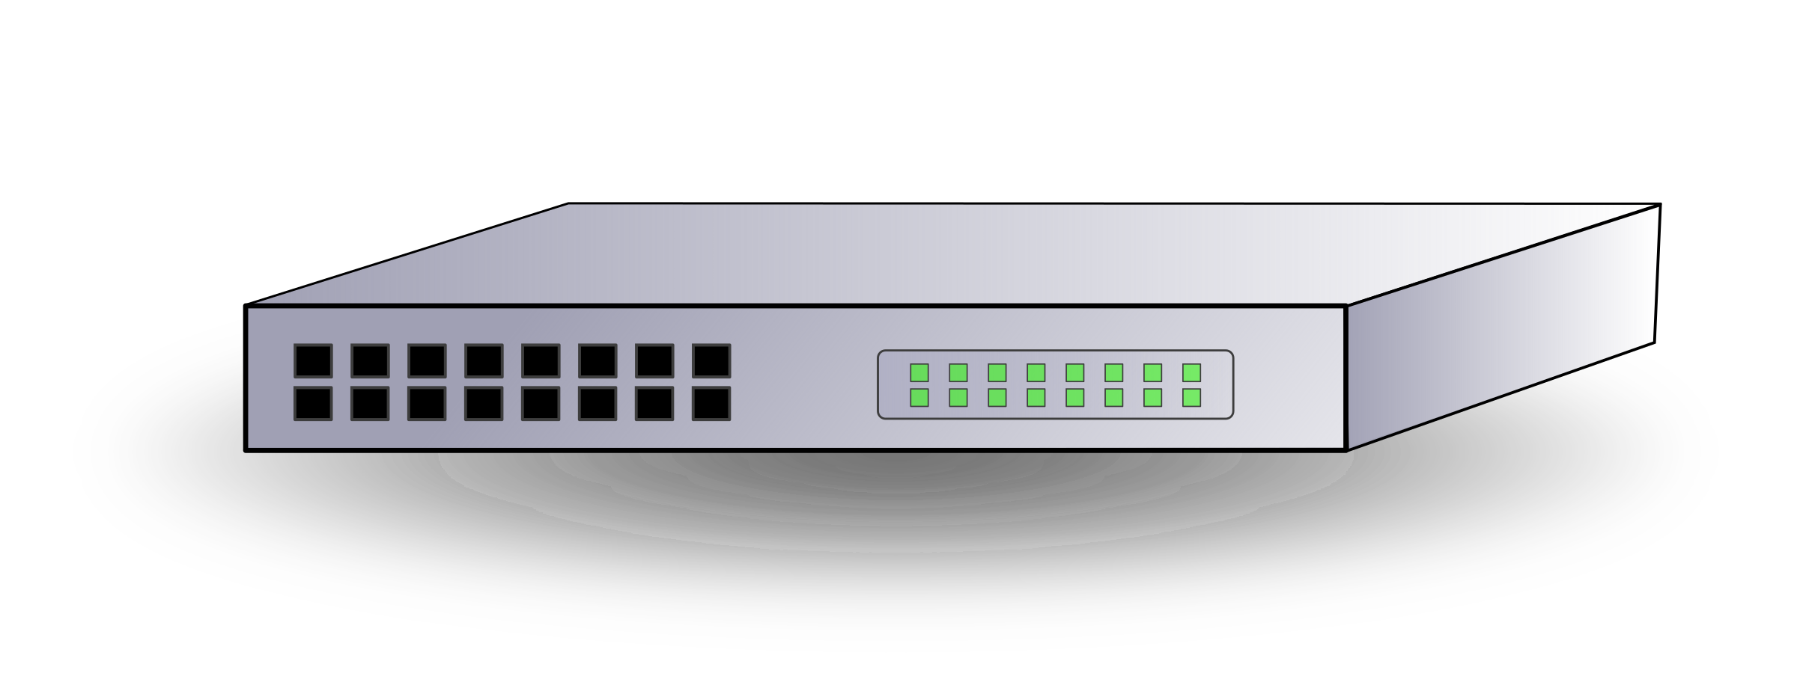


Data networks vs. PCNs
Receiver
Client
Router
Router
Router
Sender
Server
ISPs
27
Notes:
Similarities with the network model – servers, routers ISP and payments –
There’s still a notion of paths on which you want to route the payments and when these should be sent out
notion of routing or picking payments
And there is a notion of capacity on the edges that limits how much you can route

Slide 28
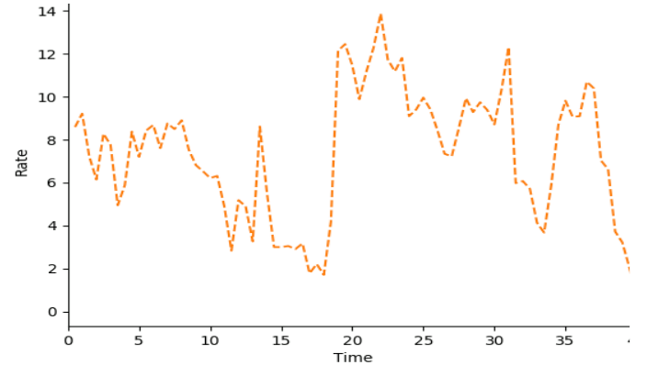
Differences in link model
Capacity = Bandwidth
Capacity = Rate
Router A
Router B
Router A
Router B
Bandwidth (Mbps)
Capacity = 0
Time
28
Notes:
Similarities with the network model – servers, routers ISP and payments –
There’s still a notion of paths on which you want to route the payments and when these should be sent out
notion of routing or picking payments
And there is a notion of capacity on the edges that limits how much you can route

Slide 29
Objective
Support high transaction throughput at low cost
Minimize on-chain transactions
Reduce collateral needed
Notes:
Collateral represents opportunity costs for routers or intermediary nodes, so if they put more money in, they expect higher routing fees per transaction and this reduces the quality of service for users using the system.

Slide 30
Key idea: Token reuse
Alice → Mary: 12 coins
Alice
2
2
Mary
Eve
Jon
Charlie
Bob
Bob → Charlie: 12 coins
Notes:
Let’s first consider how we might go about reducing collateral in the network
Consider this scenario where nothing can be sent
Let me talk about how good routing can reduce collateral - all about being able to reuse the same coin - if you split payments and reuse the same token by maintain balanced rates
show a path between alice and mary and bob and charlie

Slide 31
Key idea: Token reuse
Alice → Mary: 12 coins
Alice → Mary: 10 coins
Alice
Mary
Eve
Jon
Charlie
Bob
Bob → Charlie: 12 coins
Bob → Charlie: 10 coins
Notes:
What enabled this token reuse/takeways
Splitting and Rate control – trickling instead of sending it atomically
you can think of this as a rate control mechanism where senders trickle out transaction units as and when capacity becomes available”
What’s really enabling the token reuse is the fact that the senders are doing rate control and not only that, they are doing rate control in a way that is balanced
Balance in that the rate of the transaction was balanced in the two opposite directions
clouds make them banks and end users outside of that
These routers would be owned by companies providing the service

Slide 32
Key idea: Token reuse
Transaction splitting and rate control enable token reuse
Alice → Mary: 10 coins
Alice → Mary: 8 coins
2 coins/RTT
Alice
Mary
Eve
Jon
2 coins/RTT
Charlie
Bob
Bob → Charlie: 10 coins
Bob → Charlie: 8 coins
Notes:
What enabled this token reuse/takeways
Splitting and Rate control – trickling instead of sending it atomically
What’s really enabling the token reuse is the fact that the senders are doing rate control and not only that, they are doing rate control in a way that is balanced
Balance in that the rate of the transaction was balanced in the two opposite directions
”you can think of this as a rate control mechanism where senders trickle out transaction units as and when capacity becomes available

Slide 33
Key idea: Token reuse
Transaction splitting and rate control enable token reuse
Alice → Mary: 8 coins
Only if the rates are balanced!
Alice → Mary: 6 coins
2 coins/RTT
Alice
Mary
Eve
Jon
2 coins/RTT
Charlie
Bob
Bob → Charlie: 8 coins
Bob → Charlie: 6 coins
Notes:
Let’s first consider how we might go about reducing collateral in the network
Consider this scenario where nothing can be sent
Let me talk about how good routing can reduce collateral - all about being able to reuse the same coin - if you split payments and reuse the same token by maintain balanced rates
What enabled this token reuse/takeways
Splitting and Rate control – trickling instead of sending it atomically
What’s really enabling the token reuse is the fact that the senders are doing rate control and not only that, they are doing rate control in a way that is balanced
Balance in that the rate of the transaction was balanced in the two opposite directions
”you can think of this as a rate control mechanism where senders trickle out transaction units as and when capacity becomes available”
clouds make them banks and end users outside of that
These routers would be owned by companies providing the service

Slide 34
The Spider Network
Goal: High transaction throughput at low cost
Two main ideas:
Packetized payments: Split payments into “transaction-units” that are routed independently on multiple paths over time
Multi-path transport protocol: Decentralized congestion control algorithm based on queueing delay that promotes balanced routing
Notes:
We now focus on multi-path protocol that is derived directly from analogous congestion control algorithms. To understand why this algorithm is useful, let’s consider the routing problem first
packet switched architecture part introduce slides

Slide 35
The routing problem
Fluid model: Transactions as continuous streams
Demand Matrix
Topology
Receivers
Maximize utility for senders
c₁
0 | 1 | 2 | 0 | 0
0 | 0 | 0 | 2 | 0
1 | 0 | 0 | 0 | 0
2 | 0 | 0 | 0 | 2
0 | 1 | 1 | 0 | 0
c₆
Senders
c₃
c₂
c₄
c₅
For each edge: Total rate < Capacity
Rate on forward direction = Rate on backward direction
Notes:
Let’s better understand this problem in a simplified setting of a fluid model for transactions.
We have a given topology of routers/intermediaries with some payment channels or edges on a graph.
Limited number of tokens – takes an amount of time to be confirmed – so the rates are limited by the amount of credits in the channel,
small credits = Small capacity
question now is what rates should we be sending payments on each of the edges to maximize throughput or satisfy as much demand as possible? The objective itself could be throughput maximization or proportional fairness. We consider prop fairness. So far this is similar to typical traffic engineering problems or multi commodity flow routing.
IMPLICATION OF BALANCE: that tpt doesn’t increase with capacity – to understand blah
Multicommodity flow

Slide 36
Spider routing
Routers: Signal congestion and imbalance based on queuing delay
Receiver
Router
Router
Sender
Window 1
Window 2
Decentralized multi-path transport protocol:
Pick windows for candidate paths based on router feedback
Wischik, Damon, et al. "Design, Implementation and Evaluation of Congestion Control for Multipath TCP." NSDI 2011.
Notes:
Introduce queues only here
Given this framework, how can we approach high throughput balanced routing. Similar utility maximization problems in networking have been studied along with decentralized multipath transport based algorithms and we look to those for inspiration.
mention that multipath transport protocol is part of the solution
this is a simple protocol that is quite directly inspired by similar protocols like MPTCP in communication networks - add an MPTCP reference
We consider a multi-path transport protocol similar to MPTCP where end hosts control the rates on paths using router signals
Our main observation is that routers are able to use just queueing delay to inturn signal to senders to maintain rates that are balanced and under capacity

Slide 37
Payment channel dynamics
In-flight funds
Bob To Alice
Alice to Bob
Transaction Queue
Transaction Queue
Bob
Alice
Available funds
Notes:
What happens when the payment channel is receiving transactions faster than it can support.
X is incoming, y is service, q denotes the queue size, each red square is a packet or a transaction unit.
Initially when funds are available, packets get serviced immediately
Then they wait in a queue until funds become available when the inflight funds get confirmed
So there’s queue buildup when there’s no available capacity expected based on parallels to networking

Slide 38
Payment channel dynamics
In-flight funds
Bob To Alice
Alice to Bob
Transaction Queue
Transaction Queue
Bob
Alice
Available funds
Notes:
What happens when the payment channel is receiving transactions faster than it can support.
X is incoming, y is service, q denotes the queue size, each red square is a packet or a transaction unit.
Initially when funds are available, packets get serviced immediately
Then they wait in a queue until funds become available when the inflight funds get confirmed
So there’s queue buildup when there’s no available capacity expected based on parallels to networking
title: payment channel dynamics - what actually happens as transactions as arrive - walk them through alice and bob for an average transaction - inflight, key, money moves - consider the two cases where

Slide 39
Payment channel dynamics
In-flight funds
Bob To Alice
Alice to Bob
Transaction Queue
Transaction Queue
Bob
Alice
Available funds
Notes:
What happens when the payment channel is receiving transactions faster than it can support.
X is incoming, y is service, q denotes the queue size, each red square is a packet or a transaction unit.
Initially when funds are available, packets get serviced immediately
Then they wait in a queue until funds become available when the inflight funds get confirmed
So there’s queue buildup when there’s no available capacity expected based on parallels to networking
title: payment channel dynamics - what actually happens as transactions as arrive - walk them through alice and bob for an average transaction - inflight, key, money moves - consider the two cases where

Slide 40
Payment channel dynamics
In-flight funds
Bob To Alice
Alice to Bob
Transaction Queue
Transaction Queue
Bob
Alice
Available funds
Queues build up when rates exceed capacity
Notes:
What happens when the payment channel is receiving transactions faster than it can support.
X is incoming, y is service, q denotes the queue size, each red square is a packet or a transaction unit.
Initially when funds are available, packets get serviced immediately
Then they wait in a queue until funds become available when the inflight funds get confirmed
So there’s queue buildup when there’s no available capacity expected based on parallels to networking

Slide 41
Payment channel dynamics
In-flight funds
Alice to Bob
Bob To Alice
Transaction Queue
Transaction Queue
Bob
Alice
Available funds
Queues build up when rates are imbalanced!
Notes:
This suggests that in order to keep queues under control, we need a scheme that responds to queue buildup and reduces rates in response to that and that In turn will ensure that senders maintain rates that are under capacity and balanced
Number of congestion control protocols that do this, but we use a single 1 bit feedback to relay this back to the sender
Given this observation of queues
at what rate should every sender send transactions?
- not enough capacity, don't send
- don't send more than what is being received
we want to maintain

Slide 42
Spider router design
In-flight funds
Mark
Alice to Bob
Bob To Alice
P
Transaction Queue
Transaction Queue
Bob
Alice
Available funds
Routers mark transactions that experience high queueing delay
Notes:
What happens when the payment channel is receiving transactions faster than it can support.
X is incoming, y is service, q denotes the queue size, each red square is a packet or a transaction unit.
Initially when funds are available, packets get serviced immediately
Then they wait in a queue until funds become available when the inflight funds get confirmed
So there’s queue buildup when there’s no available capacity expected based on parallels to networking

Slide 43
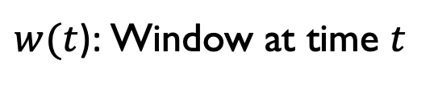
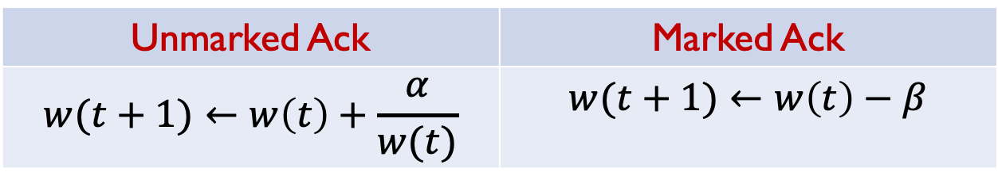
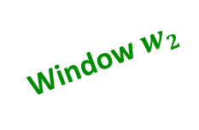

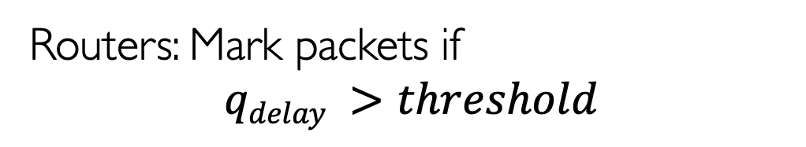
Spider routing
Routers: Mark packets if
$$qdelay >threshold$$
Receiver
Router
Router
Sender
Window $w1$
Window $w2$
Unmarked Ack | Marked Ack
$$w(t+1)←w\left(t\right)+\frac{α}{w(t)}$$ | $$w(t+1)←w\left(t\right)−β$$
$w(t$): Window at time $t$
Notes:
iN response to the marked packets, senders adjust their windows based on rules similar to traditional AIMD

Slide 44
Evaluation
Packet based simulator in Omnet++ to model transaction processing
Transactions modelled off credit card dataset
Circulation traffic pattern
Directed acyclic graph (DAG) pattern with skewed senders/receivers
Wide range of topologies:
Synthetic small world, scale free topologies
Lightning Network deployment data
Channel sizes sampled from Lightning Network
Notes:
We used a simulator to model transaction processing. We maintained a queue for transaction units that haven’t yet been completed and scheduled them a$ording to Shortest Remaining Time.
The transaction sizes and sender-receiver pairs were generated from Ripple, an existing system for currency exchange.
The payment channel network was constructed from ISP topology as well as topolpgy from Ripple itself. Fbut we focus on the ISP topology graphs here since they are easier to reason about

Slide 45
Collateral required
Circulation demand
95%
*x-axis (logarithmic) ticks represent 10x to 160x of exact Lightning Network capacities
Notes:
Mean channel size varied on the x axis. It is highly skewed
We run a demand of 30 txns/s per sender across 10 destinations. Sizes vary from 5 euros to 3930 euros
We vary the mean channel size and look at how many transactions each scheme is able to successfully complete.
All schemes inmprove with more capacity
At low capacities, LND only completes 30% of the txns
Spider completes 80% - narly 3x increase which is important given the low capacities that LN will likely work under until it is adopted
Spider requires 25% of the capacity needed by LND to sustain the same 95% of txns
LND is the atomic shortest paths described

Slide 46
Offloading achieved
20% DAG (Imbalanced) Demand
Mean channel size:16K €
Notes:
make the y axis offchain/on-chain
Offload factor: what fraction of all transactions that are done onchain to the number of transactions done off-chain out of a total budget or demand of transactions.
Spider enables 8x transactions for every transaction on-chain. So, we can get a 7x boost in throughput via effective use of payment channels in total sustain 9x more transactions alto-gether by effectively using these two.

Slide 47
Summary
Payment channels promise to improve cryptocurrencies’ scalability
Yet, the current design limits throughput and incurs significant cost for good performance
Spider uses packetized transactions and a multipath congestion control algorithm to achieve high transaction throughput at low cost
https://github.com/spider-pcn
vibhaa@mit.edu
Notes:
Schedule different based on payment priorities or reject large transactions
Routers want to maximize profits – might alter prices for this purpose
We assume perfect balance, but routers might add more funds if the perceived return is large
Privacy?
Source routing, end-hosts and routers differences, 0% circulation point - stochasticity
WHo is paying the routing fees?
Feedback:
LND - atomic shortest path routing
Circuit switched network vs packet switching

Slide 49
What’s the best we can do?
Circulation
DAG
Payment Graph
(can be routed efficiently)
(needs rebalancing)
2
1
1
1
2
=
1
1
+
1
1
2
1
1
2
1
2
1
1
1
1
1
Bob
Alice
Theorem: No routing scheme can achieve throughput greater than the circulation component
Notes:
In a traditional network, a larger capacity implies larger tpt, but in this case, the implication of balance is circ
same matrix from before can be represented like this
Circulation –portion that can be routed in balanced fashion. In other words, the rate incoming edges = rate outgoing edges at every node – can be constructed by removing cycles of constant flow from the original graph
The total of these weights is the value of the circulation
Whatever remains is the DAG and cannot be routed without additional deposits via the blockchain
How to route circulation IN THE ABSENCE OF REBALANCING
should we define rebalancing here or set up our metrics
a good system should get you the highest tpt with both the smallest of capital locked in and the smallest amount of rebalancing txns (all of this contributes to the cost of the system - either the capital or rebalancing costs)

Slide 50
Average latency by size
Circulation demand ✽ Mean Channel Size:16K €
Notes:
Mean channel size varied on the x axis. It is highly skewed
We run a demand of 30 txns/s per sender across 10 destinations. Sizes vary from 5 euros to 3930 euros
Break down by sizes. Each x axis point represents a transaction size range and the y axis denotes the percentage of txns successful in that range. Each range corresponds to an equal percentage of the total number of txns in the dataset
LR quickly degrades with size of txn
LND performs consistently until the transaction sizes are large. Likely because of the skew in payment channel sizes and a large number of them being large enough to support any number of small txns
Spider completing nearly all of the small transactions and completing 20% more than LND for even the largest 12.5% of txns

Slide 51
Tail latency by size
Circulation demand ✽ Mean Channel Size:16K €
Notes:
Mean channel size varied on the x axis. It is highly skewed
We run a demand of 30 txns/s per sender across 10 destinations. Sizes vary from 5 euros to 3930 euros
Break down by sizes. Each x axis point represents a transaction size range and the y axis denotes the percentage of txns successful in that range. Each range corresponds to an equal percentage of the total number of txns in the dataset
LR quickly degrades with size of txn
LND performs consistently until the transaction sizes are large. Likely because of the skew in payment channel sizes and a large number of them being large enough to support any number of small txns
Spider completing nearly all of the small transactions and completing 20% more than LND for even the largest 12.5% of txns

Slide 52
Effect of DAGs
20% DAG demand
Mean channel size:16K €
Notes:
Generate demands with some amount of DAG in them. Vary the amount of DAG on the x axis
We run a demand of 30 txns/s per sender across 10 destinations. Sizes vary from 5 euros to 3930 euros
look at normalized tpt (or percentage completed of amount/percentage attempted)
What we expect: All schemes degrade with more DAG
Spider performs better than LND
But no one gets optimal
Why? Deadlock???
Where to fit in deadlock discussion
why did this happen? because dags create deadlocks. let's look at a simpler example. use clouds and identify that charlie is a dag

Slide 53
Rebalancing required
20% DAG demand
Mean channel size:16K €
Notes:
MENTION THAT DAGs create skewed
In order to overcome deadlocks, we allow periodic rebalancing after every x euros has been successfully routed at a router
Rebalancing redistributes wealth across the payment channels at a router.
Interval acts as a proxy for cost – because the more you route, the more willing you are to rebalance
look at normalized tpt (or percentage completed of amount/percentage attempted) as the rebalancing interval is increased
At extremely frequent rebalancing, all schemes do much better than lack of rebalancing, but they seem to taper off at a certain tpt – reason being that in the absence of packetiziation, even frequent rebalancing can only do so mych
But as the rebalancing frequency is decreased, schemes take more hit to their tptal tpt
Spider is able to recover the 100% tpt even when rebalancing only every 10000 euros. You can think of this as routers need to only pay for one blockain txn (utmost a euro or so) for 10000 euros they route on this topology. This cost affects the routing fees they charge, which is only about 0.01% compared to the 2 – 3% charged by credit cards today.
Tiny amount of rebalancing can help a lot if you have balanced routing, small amount of rebalancing a small amount of rebalancing to just get rid of deadlocks
Success ratio vs amt rebalancing
Offload factor: what fraction of all transactions that are done onchain to the number of transactions done off-chain

Slide 54
Transaction success by size
Circulation demand ✽ Mean Channel Size:16K €
Notes:
Mean channel size varied on the x axis. It is highly skewed
We run a demand of 30 txns/s per sender across 10 destinations. Sizes vary from 5 euros to 3930 euros
Break down by sizes. Each x axis point represents a transaction size range and the y axis denotes the percentage of txns successful in that range. Each range corresponds to an equal percentage of the total number of txns in the dataset
LR quickly degrades with size of txn
LND performs consistently until the transaction sizes are large. Likely because of the skew in payment channel sizes and a large number of them being large enough to support any number of small txns
Spider completing nearly all of the small transactions and completing 20% more than LND for even the largest 12.5% of txns

